Slide 1









Whiteboardmaths.com
7
2
1
5
© 2004 All rights reserved

Slide 2
12/24 Hour Clock
midnight
1 am
2 am
3 am
4 am
5am
6 am
7 am
8 am
9 am
10 am
11 am
0000
0100
0200
0300
0400
0500
0600
0700
0800
0900
1000
1100
midday
1 pm
2 pm
3 pm
4 pm
5 pm
6 pm
7 pm
8 pm
9 pm
10 pm
11 pm
1200
1300
1400
1500
1600
1700
1800
1900
2000
2100
2200
2300
To go from 24 hour clock to 12 hour clock just subtract 12 to the hour:
Examples
2000 becomes
8 pm
2100 becomes
9 pm
1730 becomes
5:30 pm
2208 becomes
10:08 pm
2006 becomes
8:06 pm
1350 becomes
1:50 pm

Slide 3
12/24 Hour Clock
midnight
1 am
2 am
3 am
4 am
5am
6 am
7 am
8 am
9 am
10 am
11 am
0000
0100
0200
0300
0400
0500
0600
0700
0800
0900
1000
1100
midday
1 pm
2 pm
3 pm
4 pm
5 pm
6 pm
7 pm
8 pm
9 pm
10 pm
11 pm
1200
1300
1400
1500
1600
1700
1800
1900
2000
2100
2200
2300
To go from 12 hour clock to 24 hour clock just add 12 to the hour:
Examples
8 pm becomes
2000
9 pm becomes
2100
6:30 pm becomes
1830
11:30 pm becomes
2330
4:20 pm becomes
1620
3:10 pm becomes
1510

Slide 4



Time 12/24 hour clock
24
23
13
22
14
21
15
20
16
19
17
18

Slide 5
AM: Before Noon (Ante Meridiem)
0300
0515
0830
Give the am times in 24 hr clock
0545
1020
1130

Slide 6
PM: After Noon (Post Meridiem)
1500
1715
2030
Give the pm times in 24 hr clock
1745
2220
2330

Slide 7

Time
3 pm
4:45 pm
Elapsed
Time?
1500
1645
3 pm to 4 pm = 1 hour
1500 to 1600 = 1 hour
4 pm to 4:45 pm = 45 minutes
1600 to 1645 = 45 minutes
Elapsed time = 1 hour 45 minutes
Elapsed time = 1 hour 45 minutes

Slide 8
Time
7:10 pm
9:30 pm
Elapsed
Time?
1910
2130
7:10 pm to 9:10 pm = 2 hours
1910 to 2110 = 2 hours
9:10 pm to 9:30 pm = 20 minutes
2110 to 2130 = 20 minutes
Elapsed time = 2 hour 20 minutes
Elapsed time = 2 hour 20 minutes

Slide 9
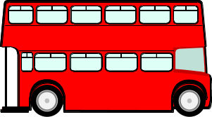
Using Timetables
*
*
Alton Bus Station
0825
0925
1025
2025
2125
2225
*
Bigby
0837
0937
1037
And
2037
2137
2237
*
Catby
0843
0943
1043
Every
2043
2143
2243
*
Worsley
0848
0948
1048
Hour
2048
2148
2248
Atcliffe
0854
0954
1054
Until
2054
2154
2254
*
*
*
*
Milfield
0902
1002
1102
2102
2202
2302
*
*
Scawby Bus Station
0914
1014
1114
2114
2214
2314
*
1. What time does the 0825 bus from Alton arrive at Scawby?
0914
2. What time does the 0943 bus from Catby arrive at Scawby?
1014
3. What time does the 2048 bus from Worsley arrive at Milfield?
2102
4. How long does it take to get from Atcliffe to Milfield?
8 min
5. How long does it take to get from Alton to Scawby?
49 min
6. What time does the last bus from Bigby arrive at Milfield?
2302

Slide 10
Using Timetables
Alton Bus Station
0825
0925
1025
2025
2125
2225
Bigby
0837
0937
1037
And
2037
2137
2237
Catby
0843
0943
1043
Every
2043
2143
2243
Worsley
0848
0948
1048
Hour
2048
2148
2248
Atcliffe
0854
0954
1054
Until
2054
2154
2254
Milfield
0902
1002
1102
2102
2202
2302
Scawby Bus Station
0914
1014
1114
2114
2214
2314
Mary lives at Bigby. She has a dentist appointment at Scawby at 1110. What is the latest bus she can catch to ensure that she is on time?
0937
Robert lives at Alton. He catches the first bus of the day to visit a friend in Atcliffe. He then travels on to Scawby, arriving there at 1414. What time did he leave Atcliffe?
1354

Slide 11

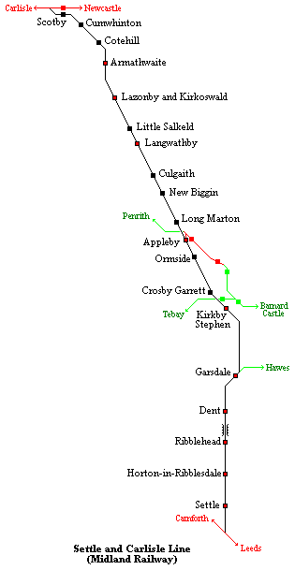
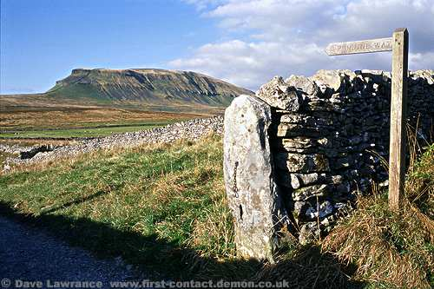
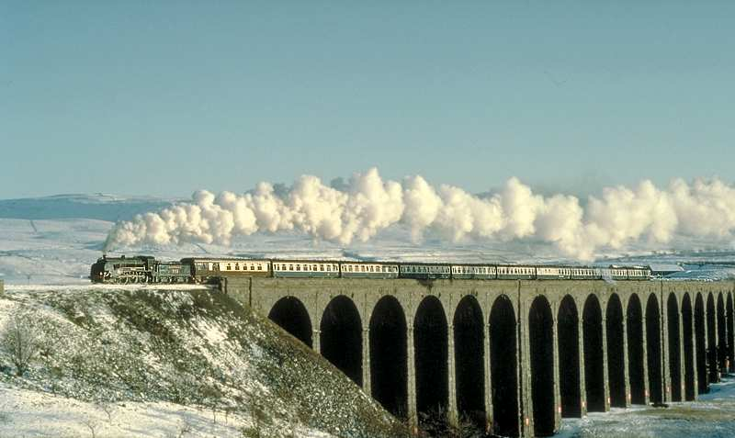
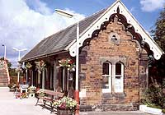
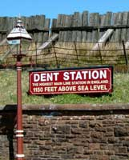

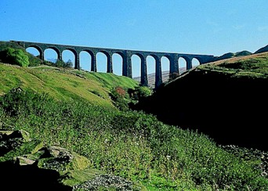
The Settle To Carlisle Railway

Slide 12

Settle to Carlisle
Settle
0950
1042
1146
1349
1545
1715
1854
2023
Horton
0959
-
1155
1357
1554
1725
1903
2031
Ribblehead
1007
-
1203
1405
1602
1733
1911
2041
Dent
1016
-
1212
1415
1611
1742
1920
-
Garsdale
1022
-
1218
1420
1617
1748
1928
-
Kirkby. S
1034
1120
1230
1433
1629
1759
1938
-
Appleby
1048
1134
1244
1445
1642
1812
1951
-
Langwathby
1102
-
1258
1459
1656
1826
2005
-
Lazonby & K
1107
-
1303
1504
1701
1831
2010
-
Armthw’te
1115
-
1311
1513
1709
1839
2018
-
Carlisle
1132
1215
1328
1530
1726
1856
2035
-
No Presets

Slide 13
Using Timetables
Alton Bus Station
0825
0925
1025
2025
2125
2225
Bigby
0837
0937
1037
And
2037
2137
2237
Catby
0843
0943
1043
Every
2043
2143
2243
Worsley
0848
0948
1048
Hour
2048
2148
2248
Atcliffe
0854
0954
1054
Until
2054
2154
2254
Milfield
0902
1002
1102
2102
2202
2302
Scawby Bus Station
0914
1014
1114
2114
2214
2314
No Presets

Slide 14



Calendar 2004 (Leap Year)
J a n u a r y
F e b r u a r y
M a r c h
M |  | 5 | 12 | 19 | 26
T |  | 6 | 13 | 20 | 27
W |  | 7 | 14 | 21 | 28
T | 1 | 8 | 15 | 22 | 29
F | 2 | 9 | 16 | 23 | 30
S | 3 | 10 | 17 | 24 | 31
S | 4 | 11 | 18 | 25
 | 2 | 9 | 16 | 23
 | 3 | 10 | 17 | 24
 | 4 | 11 | 18 | 25
 | 5 | 12 | 19 | 26
 | 6 | 13 | 20 | 27
 | 7 | 14 | 21 | 28
1 | 8 | 15 | 22 | 29
1 | 8 | 15 | 22 | 29
2 | 9 | 16 | 23 | 30
3 | 10 | 17 | 24 | 31
4 | 11 | 18 | 25
5 | 12 | 19 | 26
6 | 13 | 20 | 27
7 | 14 | 21 | 28
A p r i l
M a y
J u n e
M |  | 5 | 12 | 19 | 26
T |  | 6 | 13 | 20 | 27
W |  | 7 | 14 | 21 | 28
T | 1 | 8 | 15 | 22 | 29
F | 2 | 9 | 16 | 23 | 30
S | 3 | 10 | 17 | 24
S | 4 | 11 | 18 | 25
 | 3 | 10 | 17 | 24 | 31
 | 4 | 11 | 18 | 25
 | 5 | 12 | 19 | 26
 | 6 | 13 | 20 | 27
 | 7 | 14 | 21 | 28
1 | 8 | 15 | 22 | 29
2 | 9 | 16 | 23 | 30
 | 7 | 14 | 21 | 28
1 | 8 | 15 | 22 | 29
2 | 9 | 16 | 23 | 30
3 | 10 | 17 | 24
4 | 11 | 18 | 25
5 | 12 | 19 | 26
6 | 13 | 20 | 27
30 days hath September, April, June and November. All the rest have 31 except February alone, which has 28 days clear but 29 in a leap year.

Slide 15
Calendar 2004 (Leap Year)
J u l y
A u g u s t
S e p t e m b e r
M |  | 5 | 12 | 19 | 26
T |  | 6 | 13 | 20 | 27
W |  | 7 | 14 | 21 | 28
T | 1 | 8 | 15 | 22 | 29
F | 2 | 9 | 16 | 23 | 30
S | 3 | 10 | 17 | 24 | 31
S | 4 | 11 | 18 | 25
 | 2 | 9 | 16 | 23 | 30
 | 3 | 10 | 17 | 24 | 31
 | 4 | 11 | 18 | 25
 | 5 | 12 | 19 | 26
 | 6 | 13 | 20 | 27
 | 7 | 14 | 21 | 28
1 | 8 | 15 | 22 | 29
 | 6 | 13 | 20 | 27
 | 7 | 14 | 21 | 28
1 | 8 | 15 | 22 | 29
2 | 9 | 16 | 23 | 30
3 | 10 | 17 | 24
4 | 11 | 18 | 25
5 | 12 | 19 | 26
O c t o b e r
N o v e m b e r
D e c e m b e r
M |  | 4 | 11 | 18 | 25
T |  | 5 | 12 | 19 | 26
W |  | 6 | 13 | 20 | 27
T |  | 7 | 14 | 21 | 28
F | 1 | 8 | 15 | 22 | 29
S | 2 | 9 | 16 | 23 | 30
S | 3 | 10 | 17 | 24 | 31
1 | 8 | 15 | 22 | 29
2 | 9 | 16 | 23 | 30
3 | 10 | 17 | 24
4 | 11 | 18 | 25
5 | 12 | 19 | 26
6 | 13 | 20 | 27
7 | 14 | 21 | 28
 | 6 | 13 | 20 | 27
 | 7 | 14 | 21 | 28
1 | 8 | 15 | 22 | 29
2 | 9 | 16 | 23 | 30
3 | 10 | 17 | 24 | 31
4 | 11 | 18 | 25
5 | 12 | 19 | 26
30 days hath September, April, June and November. All the rest have 31 except February alone, which has 28 days clear but 29 in a leap year.

